Slide 1
Python Web Programming

Slide 2
Today’s Topic
Day 5: Python Programming – Part 3
Ø Modules
Ø Exception Handling

Slide 3
Modules

Slide 4

Motion design
User experience
Pysical Compung
HTML, CSS,JS

Slide 5
Exception Handling

Slide 6
Try-Catch
The try block lets you test a block of code for errors.
The except block lets you handle the error.
The else block lets you execute code when there is no error.
The finally block lets you execute code, regardless of the result of the try- and except blocks.

Slide 7
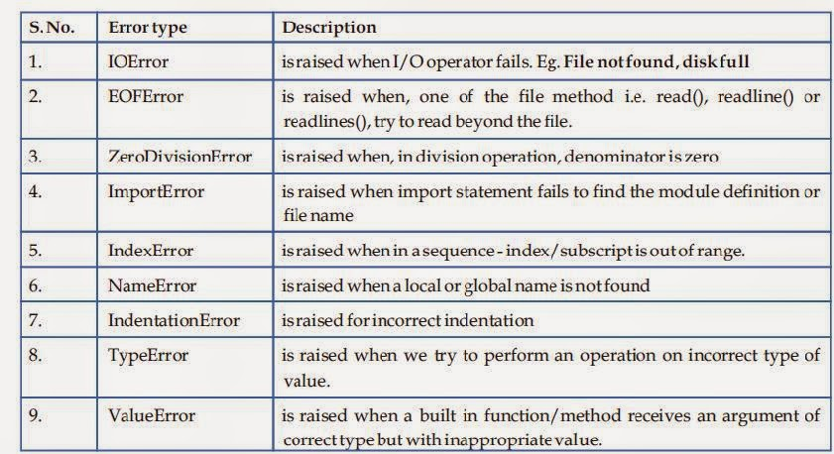
Types of Exception

Slide 8
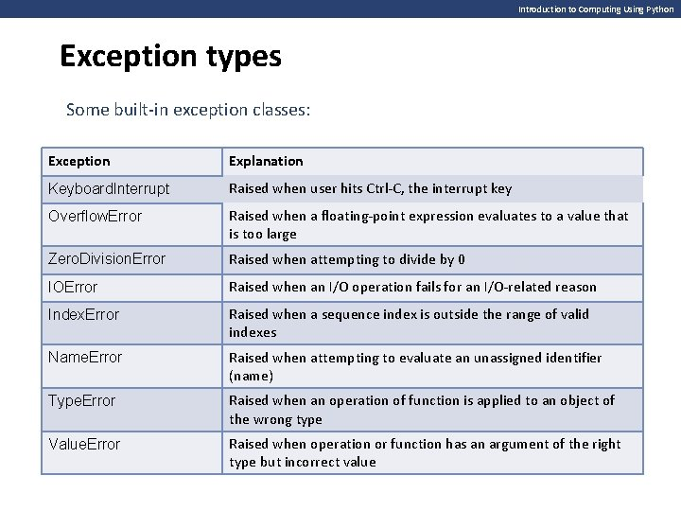

Slide 9
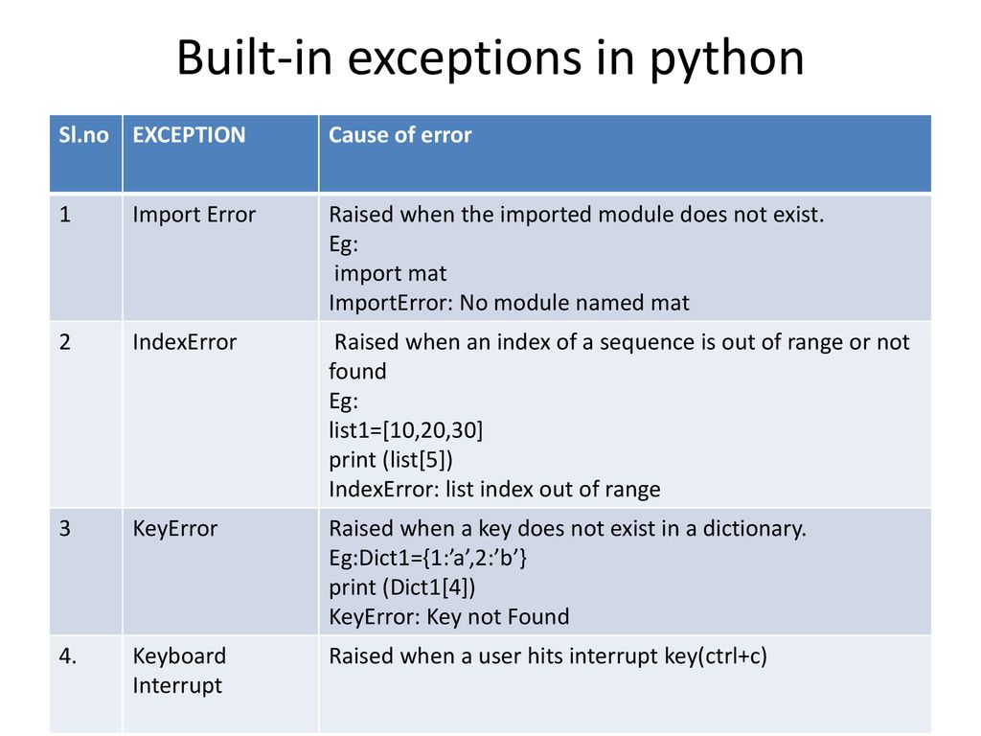

Slide 10
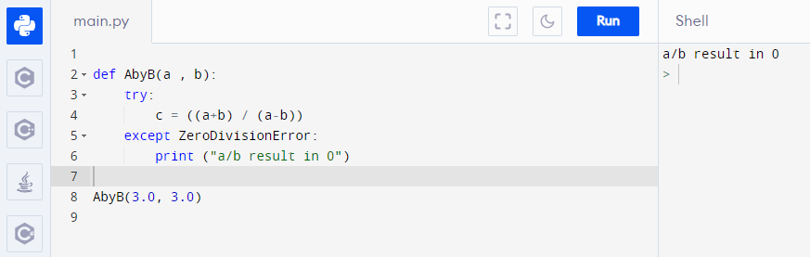
try:
print(x)
except:
print("Something went wrong")
finally:
print("The 'try except' is finished")

Slide 11
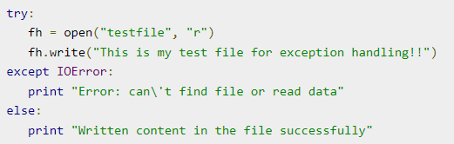
File/IO

